Slide 1
Authentication for Web APIs using JSON Web Tokens and Passport
Frank Walsh, 2020

Slide 2

Agenda This Week
Schema Methods and Sessions
JSON Web Tokens (JWT)
Authentication
Salting with BCrypt
Passport
Mongoose Middleware(hooks)
Use Case – Login/Register for React App using JWT/Passport

Slide 3
Schema Methods

Slide 4
Example: Using Schema Methods for Simple Authentication
Restrict access to API (require authentication):
Create users schema with methods for
Finding users
Checking password
Use express-session middleware to create and manage user session (using cookies)
Create an authentication route to set up “session”
Create your own authentication middleware and place it on /api/movies route

Slide 5
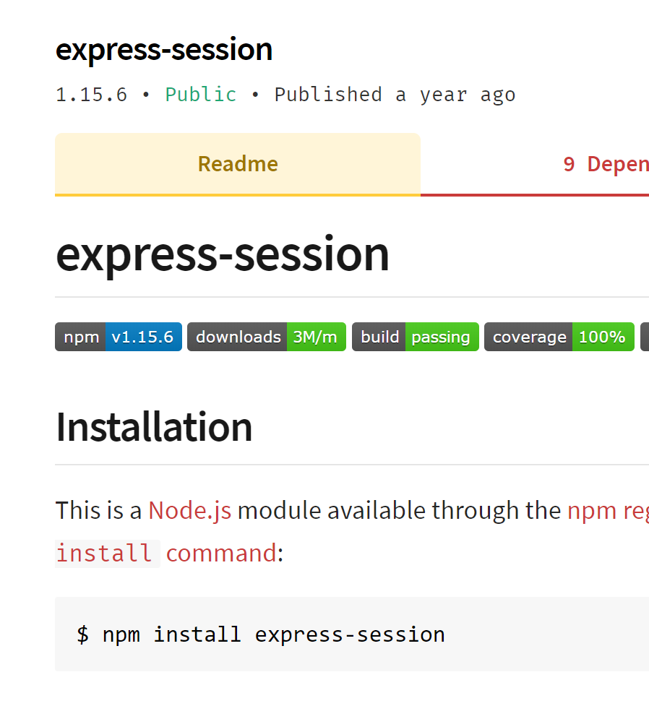
Aside: Sessions
Requests to Express apps are stand-alone by default
no request can be linked to another.
By default, no way to know if this request comes from a client that already performed a request previously.
Sessions are a mechanism that makes it possible to “know” who sent the request and to associate requests.
Using Sessions, every user of you API is assigned a unique session:
Allows you to store state.
The express-session module is middleware that provides sessions for Express apps.

Slide 6
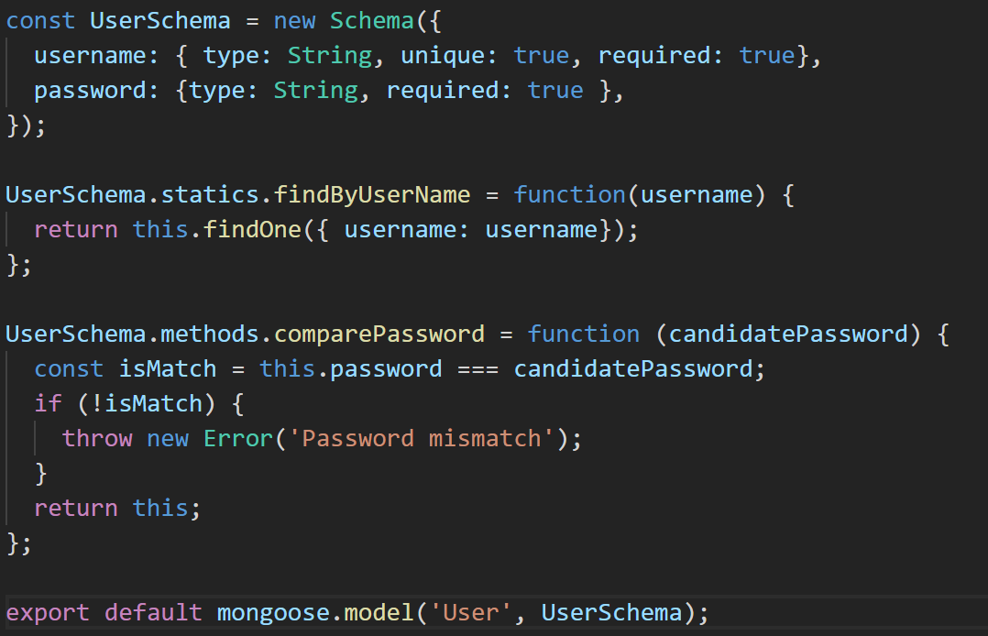
1. User Schema with Static & Instance Methods
Static Method: belongs to schema. Independent of any document instance
Instance Method: belongs to a specific document instance.

Slide 7
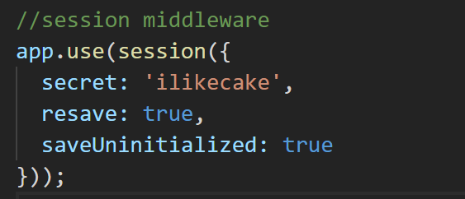
2. express-session middleware
Session middleware that stores session data on server-side
Puts a unique ID on client
Add to Express App middleware stack:

Slide 8
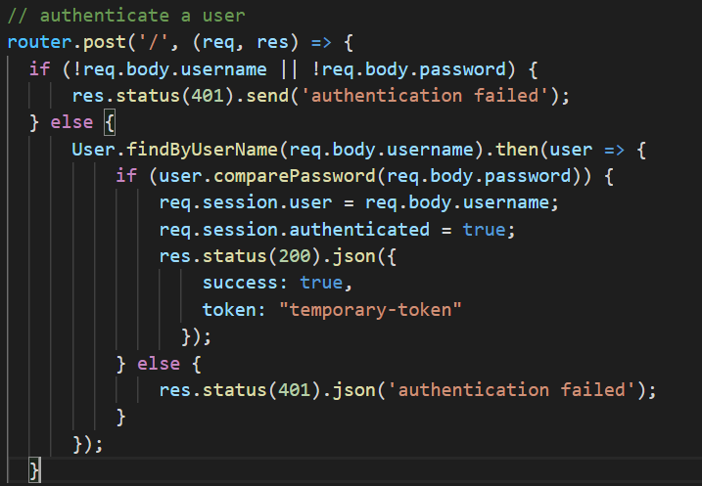
3. Use User Route to authenticate
Use /api/user to authenticate, passing username and password in HTTP body
/api/users/index.js
Using static method to find User document
Using instance method to check password
/index.js

Slide 9
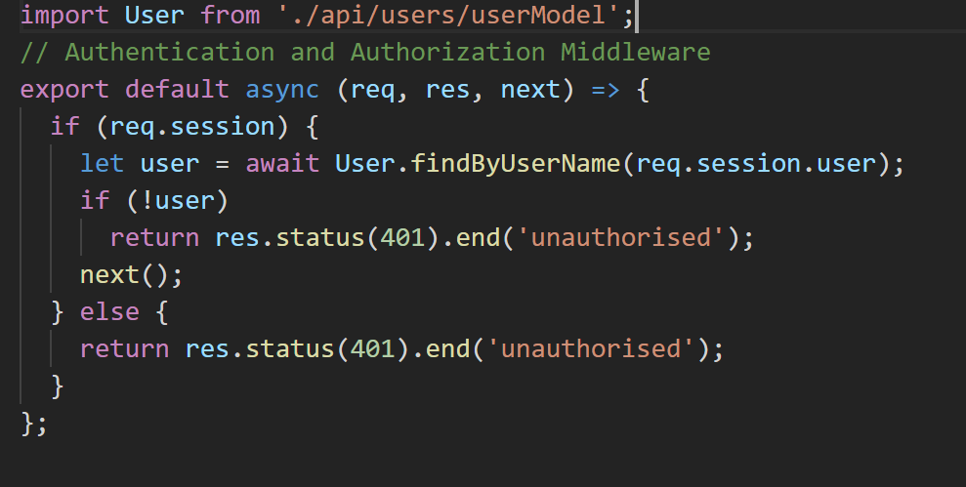
4. Add Authentication Middleware
authenticate.js
Checks for user ID in session object. If exists, called next middleware function, otherwise end req/res cycle with 401
index.js
Authentication middleware applied on /api/movies route.

Slide 10
Javascript Web Tokens

Slide 11
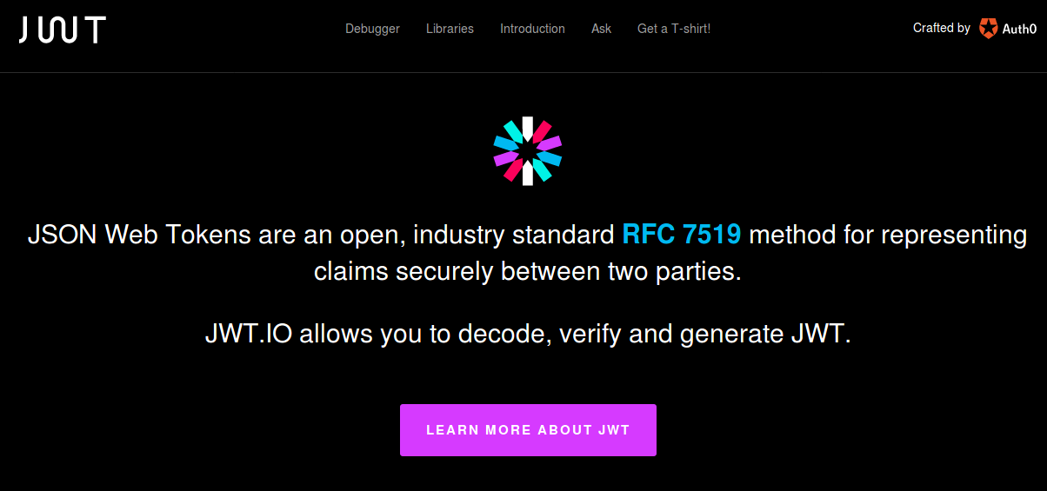
Authentication options
Many solutions for Authentication
Cookies, basic-auth, JWT, OAuth.
Web-based Identity Federation/3rd Party (Firebase)
JSON Web Tokens (JWT)
Tokens means no need to keep sessions or cookies
In keeping with REST stateless principle – token sent on each request
Token stored on client, usually in local storage of client.
Notes:
OAuth (Open Authorization) is an open standard for token-based authentication and authorization on the Internet.
Cookie authentication uses HTTP cookies toauthenticate client requests and maintain session information.
In basic HTTP authentication, a request contains a header field of the form Authorization: Basic <credentials>, where credentials is the base64 encoding of id and password joined by a colon.

Slide 12
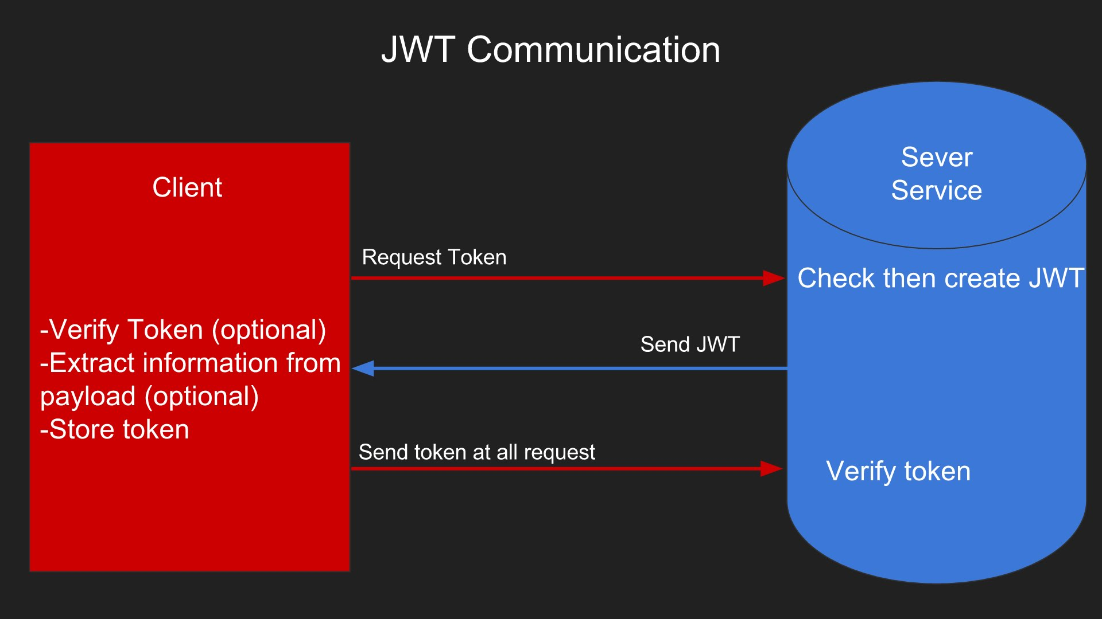
JSON Web Tokens
Notes:
defines a compact and self-contained way for securely transmitting information between parties as a JSON object.
information can be verified and trusted because it is digitally signed.
Once the user is logged in, each subsequent request will include the JWT, allowing the user to access routes, services, and resources that are permitted with that token. Single Sign On is a feature that widely uses JWT nowadays, because of its small overhead and its ability to be easily used across different domains.

Slide 13
Username and Password Scenario
Scenario
User signs up to access an API (username & password)
Create a new user in database
Use new username to create a JWT
Send JWT back to user
User stores JWT
JWT used on every subsequent request to protected resource
Authentication and Identification
...because username was used to generate JWT.

Slide 14
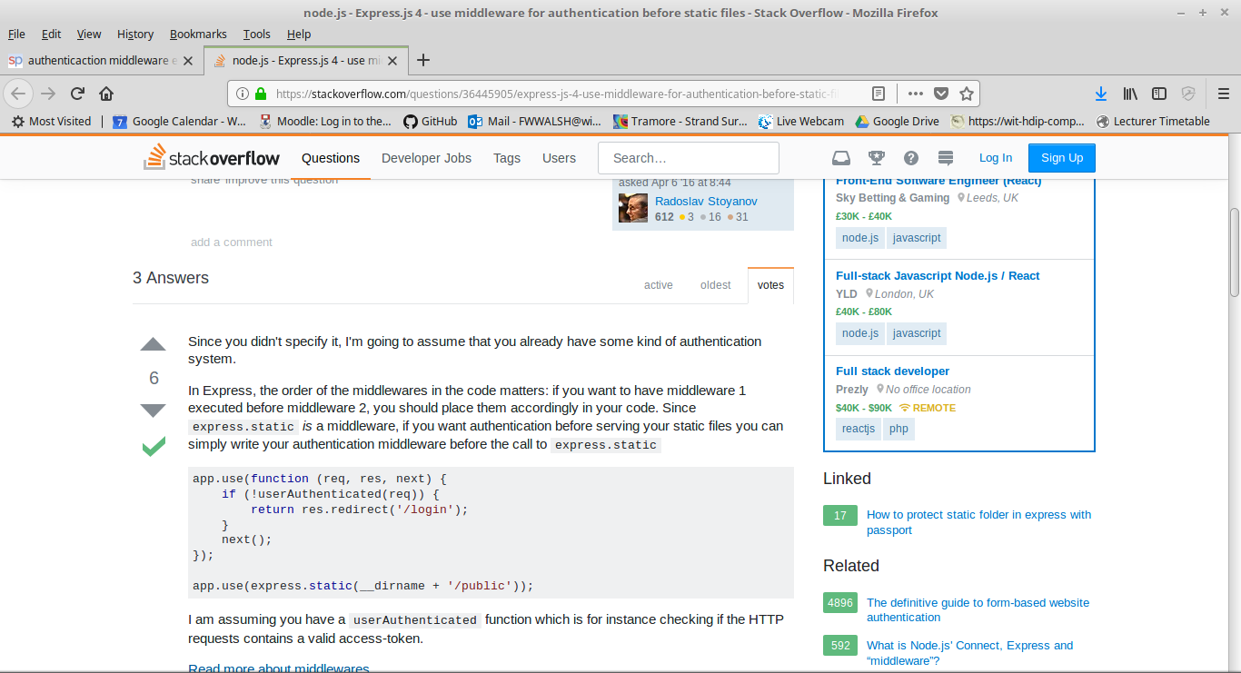
Authentication Middleware
Need express middleware to manage user login
Need Express middleware to restrict access to sensitive routes.
Options
Roll our own(previous express-sessions example…)
Use existing framework/package

Slide 15
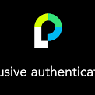
Passport
Passport is authentication middleware
Flexible and modular.
Easy to retrospectively drop into an Express app.
Lots of "strategies" for authentication
Username/Password
Facebook
Twitter

Slide 16
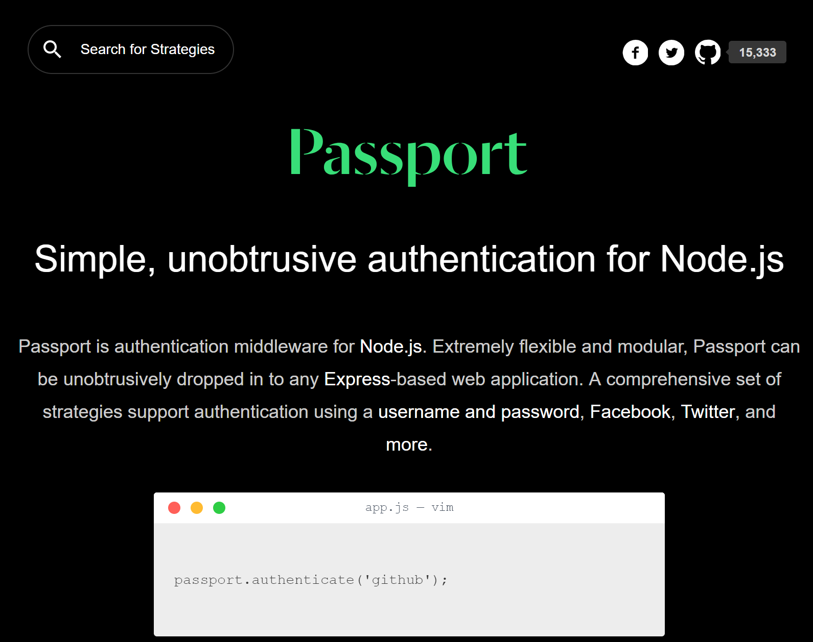

Slide 17
Passport Overview
Passport offers different authentication mechanisms as Strategies
You install just the modules you require for a particular strategy
Authenticate by calling passport.authenticate()
specify which strategy to use.
The authenticate() function signature is a standard Express middleware function…
Just drop it in..

Slide 18
Requirements for Authentication: movie-api
Restrict access to authenticated users.
Provide User API to login/register.
Users should only have to log in once:
Ideally identified and authenticated in subsequent requests.
Username and Password authentication.
No clear case passwords like last week!!!
Hash/Salt all passwords in MongDB

Slide 19
Web authentication – credentials
Credentials should be stored securely in a centralised location
Should only be readable by suitably privileged users
Credentials should not find their way into hidden fields, headers, cookies
Should not be “hard coded”
Passwords should be “salted” and “hashed”
Salting involves appending random bits to each password
Salted password is then hashed (i.e. one-way encrypted) for storage
Objective is to store something derived from the password that allows an entered candidate password to be checked …
… but such that the password cannot be retrieved (by anybody, even an administrator)

Slide 20
Passwords & Salting
Password Creation
Password Verification
Plain Text Password
Salt
Plain Text Password
Hashing function
Hashing function
Hash
Do They Match?
Stored Credentials
Stored Credentials
Salt
Hash
Salt
Hash
Notes:
Password hashing is a simple way of storing users’ passwords in a database. Users enter their password, which is then inserted into a hash function that then maps the users password to a fixed-length string of random characters. Some common hash functions include MD5 and SHA256.
A salt is a random character string that is added to the beginning or the end of a password. This salt is unique to each user, and is stored in the database along with the username and salted-hashed password.
Storing a Password:
Generate super long salt with a CSPRNG
Prepend the salt to the user password and hash it
Save the salt and the hash in the database
Checking a Password:
Get the salt and hash from the database
Prepend the salt to the submitted password and hash it
Compare the hashes. If they are equal, the password is correct

Slide 21

Why Salt?
Frustrates dictionary attacks.
Prevents duplicate passwords appearing as duplicates in password db (using different Salts)
Protects users where same password is reused on different systems/sites.
This Photo by Unknown Author is licensed under CC BY-SA

Slide 22
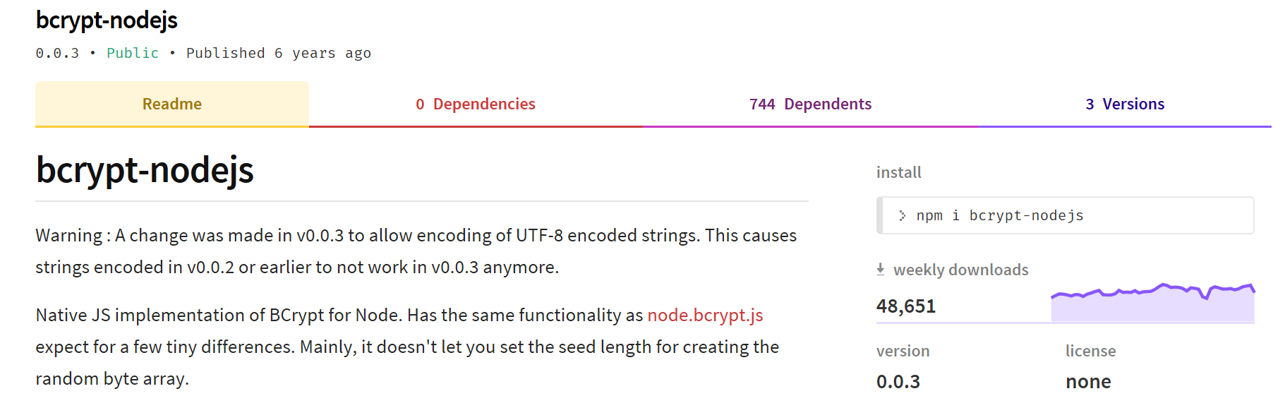
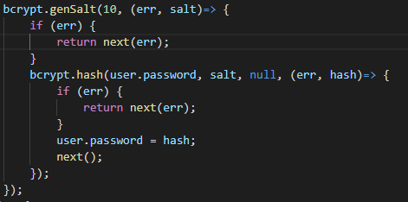
Salting and Encrypting in Node.js/Express
Several NPM packages available.
Also in other languages (Java)

Slide 23
Encrypting - Mongoose User Model

Slide 24
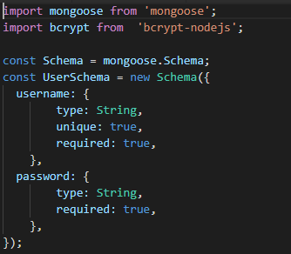
Create Mongoose User Model
Use Mongoose to specify user model:

Slide 25
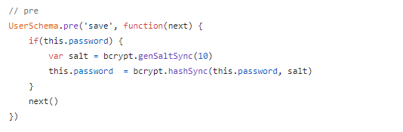
Mongoose Middleware: Hash/Salt Passwords
Mongoose supports Middleware (also called pre and post hooks).
Can use, like Express middleware, to process documents
Use bcrypt package to hash and salt passwords

Slide 26
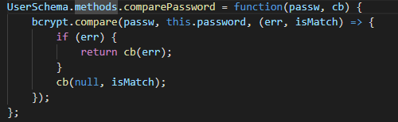
Mongoose Methods: compare passwords
You can define instance and static methods in Mongoose Schemas.
For authentication, define a comparePassword(..) instance method
Use this to authenticate users
Bcrypt used to compare with hashed/salted password.

Slide 27
User API: User Routes
Create new router to support following API
Route | GET | POST | PUT | DELETE
/api/users | List all users | Register/ Authenticate User | N/A | N/A

Slide 28
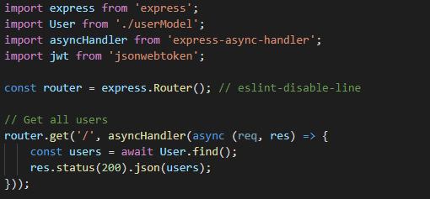
User API: Get users
Create a route to list all users:

Slide 29
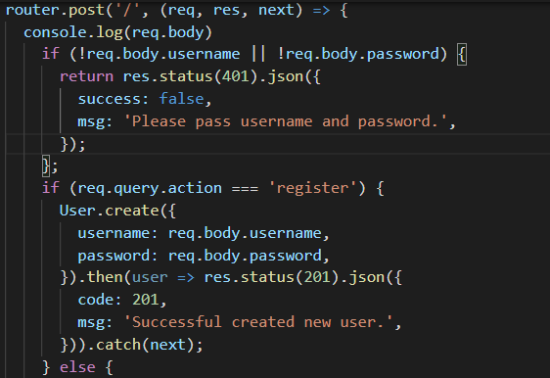
User API: Register new user
Will use query string of URL to indicate action to take on resource
Action===register will register new user
http://localhost:8080/api/users?action=register

Slide 30
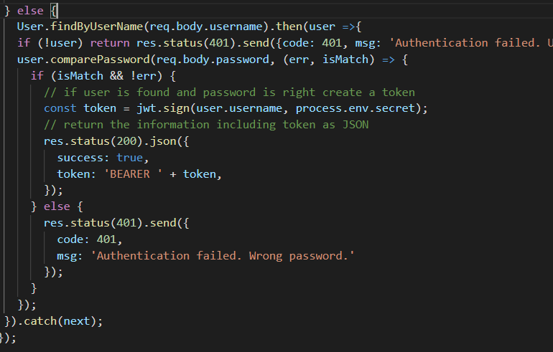
User API: Authenticate User
Find user and compare password using user model
Generate and return JWT token using username field
Client needs to keep token for subsequent messaging
store JWT in local storage.

Slide 31
Users API: User Collection
Users Collection
_id | "5ad46fccada1ab2d67b349ec"
username | "user1"
password | "$2a$10$9r3v12AvPPSkcpJXiohGgehGY50gvgWFV9AAABi37caggsPmxBdwW"
__v | 0
1
_id | "5ad46fccada1ab2d67b349ed"
username | "user2"
password | "$2a$10$YZlmbnUSZhBq9FAsAqKTyOJk8uXEweC7XtTNY/ozu8aMGXDW07Xxa"
__v | 0
Hashed/Salted value for password "test1"

Slide 32
Protecting Routes with Passport

Slide 33
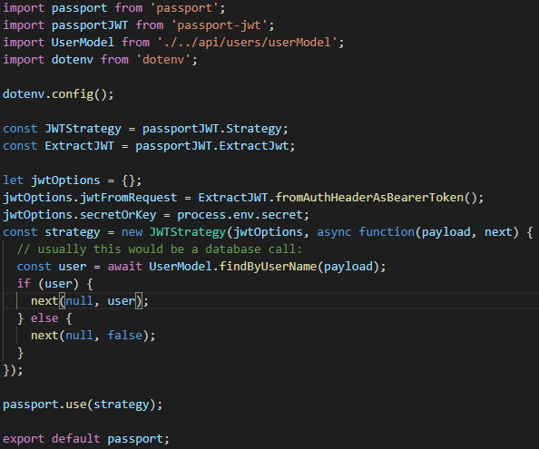
Protecting API Routes: Passport JWT Policy
/auth/index.js
Passport strategies are a middleware functions that a requests runs through before getting to the actual route.
If the authentication strategy fails,
callback will be called with an error
the route will not be called and a 401 Unauthorized response will be sent.

Slide 34

Protecting API Routes: initialise and add Middleware
In /index.js of express app
// import passport configured with JWT strategy
…
// initialise passport
// Add passport.authenticate(..) to middleware stack for protected routes

Slide 35
React Apps and JWT

Slide 36
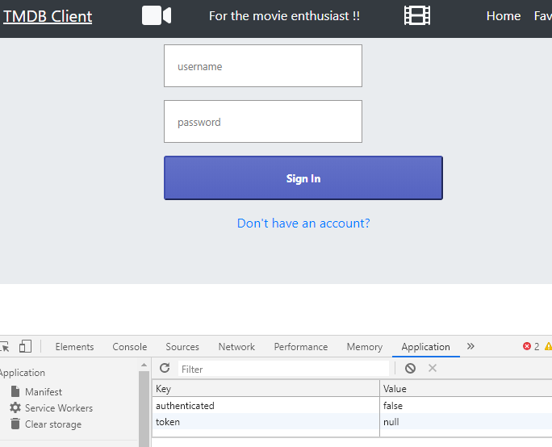
MovieDB App
We want to:
Replace with calls to MovieDB API
Provide login/signin capabilities.
Only allow signed in users to see Movies and add stuff

Slide 37
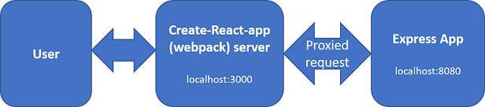
Proposed Architecture
Create-React-app uses Webpack development server.
MovieDB API is an Express.js app.
Configure Webpack server to "proxy" any unknown requests to Express app
Just need "proxy":"http://localhost:8080" entry in package.json.
Removes Cross-Origin-Resource-Sharing (CORS) issues with the browser

Slide 38
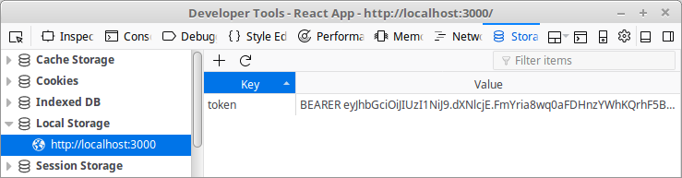
JavaWebToken Storage
Most browsers/devices have local storage .Can access using localStorage object.
localStorage.setItem('token', token);
const token = localStorage.getItem('token');

Slide 39
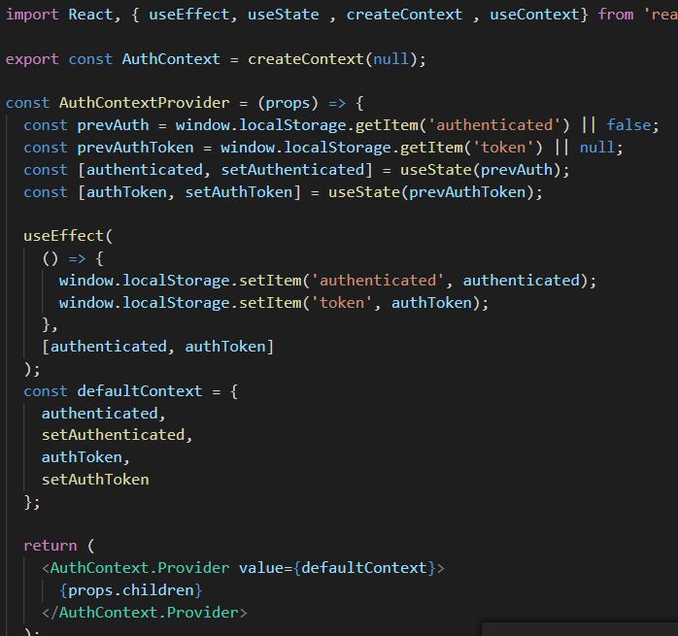
Contexts
Create a Authentication Context in MovieDB React App.
As with Movie and Genre contexts, use it to pass data through the component tree
Share authentication details between components

Slide 40
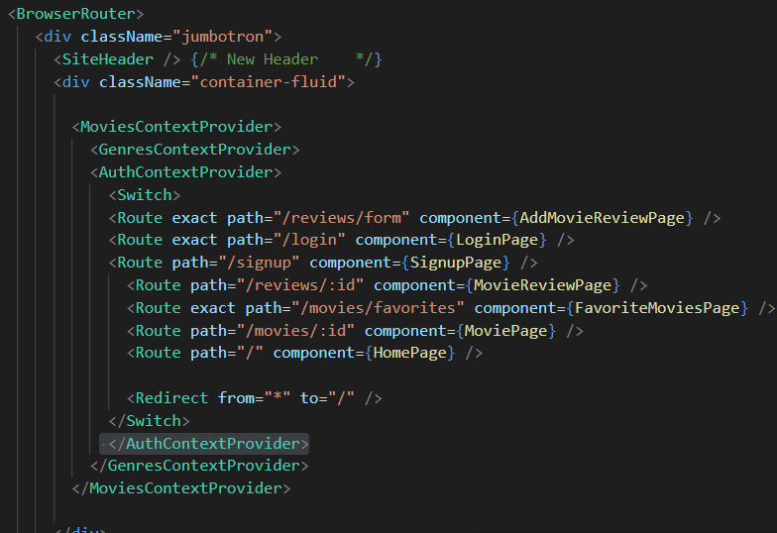
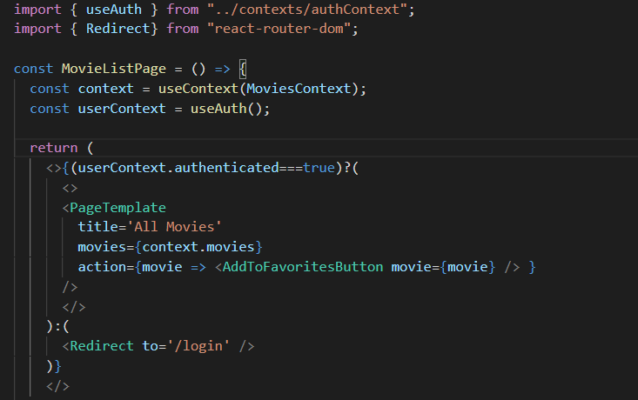
Use Context Provider in React App
Import context and use it to check authentication status

Slide 41
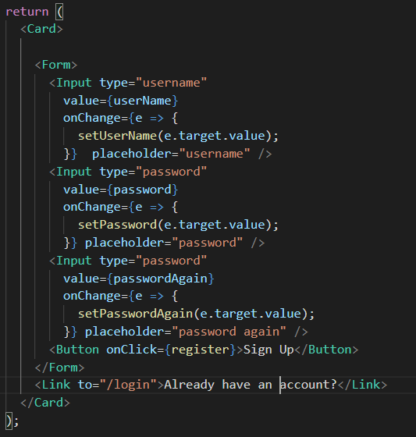
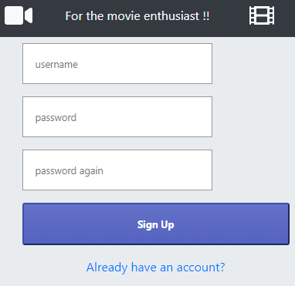

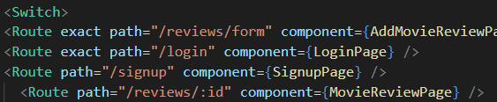
Login/Register Component
Add to App router (in index.js)

Slide 42
Summary
Create User model with Mongoose
Pre-save hook to salt/hash passwords
Instance method to compare passwords
Implement user API to authenticate/signup users
Sign JWT tokens with user name
Add a JWT Strategy to Passport.js
Use passport.authenticate(…) to secure server-side routes
Add to middleware stack.

